Slide 1
Lexical Analyser
Group 5

Slide 2
What is a Lexer?
In computer science, lexical analysis is the process of converting a sequence of characters (such as in a computer program or web page) into a sequence of tokens. A program that performs lexical analysis may be termed a lexer, tokenizer or scanner.

Slide 3
What we use: Flex/Flex++
The familiarity of using Flex, along with the vast amount of documentation made it easy to get started.
We took inspiration from the C lexer and modelled our .l file after it

Slide 4
What we use: Flex/Flex++
We also added Ganitham-specific keywords like Alphabet, Graph and Set.
We also modelled a lexer in C++, to expose ourselves to the diversity of thought associated with coding a lexer in multiple languages.

Slide 5
Flex++ Specific Features
C++ makes it easy to create a hashmap through the usage of std::unordered_map<> . This allows us to create a symbol table of the encountered identifiers, thus anonymising the programmer’s variable names. This will also be useful in the later stages, as it gives a predictable format for the identifier tokens.
Using an unordered_map provides the advantage of O(1) avg lookup and insertion times, thus keeping the pace close to the implementation without symbol tables.

Slide 6
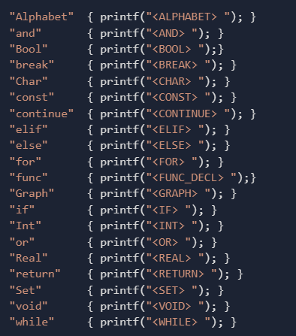
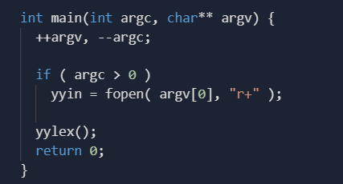
Code

Slide 7
Thank You

